Slide 1
Arduino LED Blink and Button Control
Understanding Components, Wiring, and Code
https://www.tinkercad.com/

Slide 2
Key Components
-Arduino UNO R3: the microcontroller board that runs our code.
-Breadboard: convenient board for connecting components without soldering.
-LED: emits light when current flows through it.
-Resistor: limits current to protect the LED from damage.
-Push Button: allows user input to control circuits.

Slide 3
Task 1 – LED Blink
Goal: Make an LED blink on and off automatically.
Wiring: LED anode to pin 13, cathode through resistor to GND.
Code: Sets pin 13 as OUTPUT, turns LED HIGH and LOW with delays.
Purpose: Introduces digital output and timing with delay()

Slide 4
Task 1 – Why We Need Each Part
Arduino UNO: provides programmable control signals.\
LED: visual indicator to show output status.
Resistor: ensures safe current for LED longevity

Slide 5
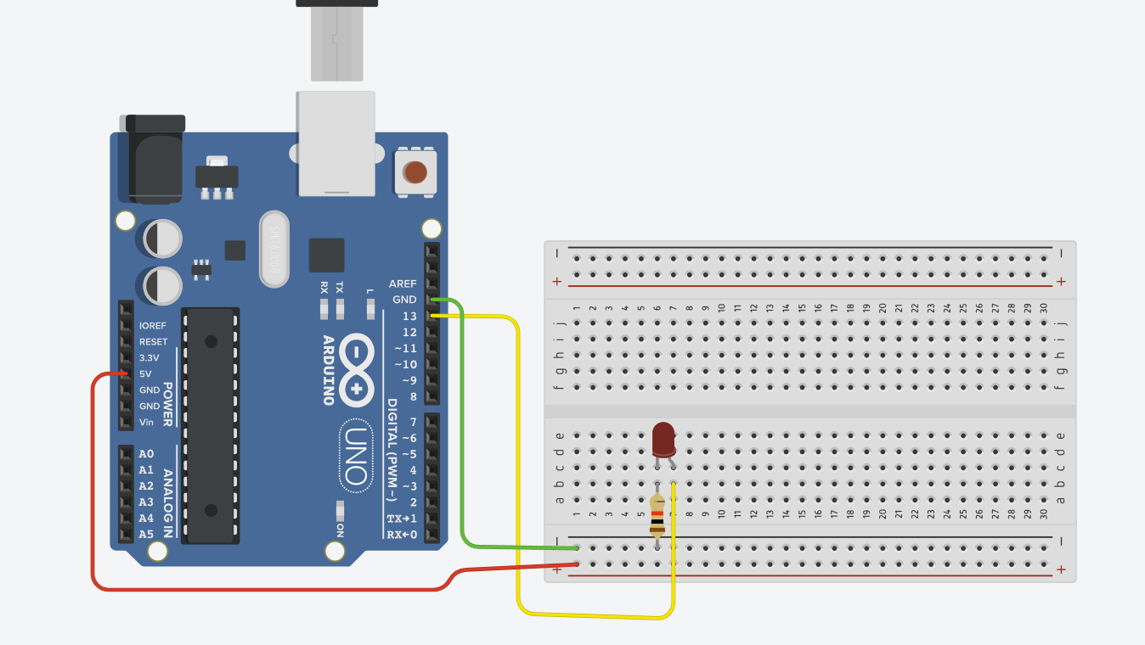

Slide 6
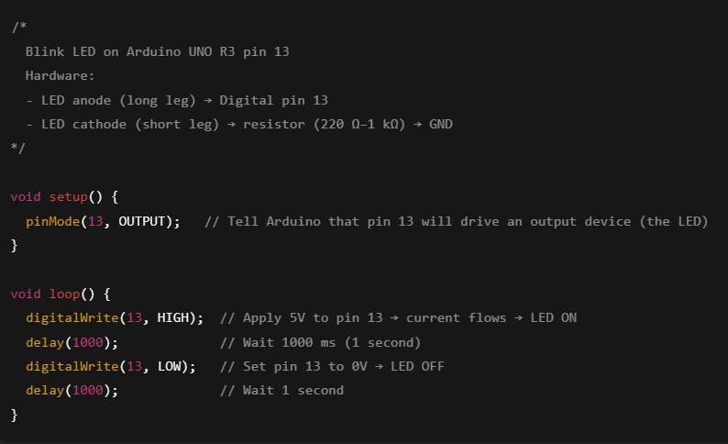
CODE
What the code does (quick tour)
pinMode(13, OUTPUT): configures pin 13 as a digital output.
digitalWrite(13, HIGH/LOW): sets the output voltage HIGH (5V) or LOW (0V).
delay(ms): pauses the program for the given milliseconds—this creates the visible blink timing.
The loop() runs forever: ON → wait → OFF → wait → repeat.

Slide 7
Task 2: Button Controlled Blink
Goal: LED blinks only when button is pressed.
Wiring: Button connected between pin 6 and GND
Code: Reads button state (LOW when pressed due to INPUT_PULLUP).
Behavior: LED blinks while button is pressed.

Slide 8
Task 2 – Why We Need Each Part
Push Button: allows interactive user input.
Internal Pull-up: simplifies wiring and ensures stable signal.
Same LED & resistor: for visual feedback and protection.

Slide 9
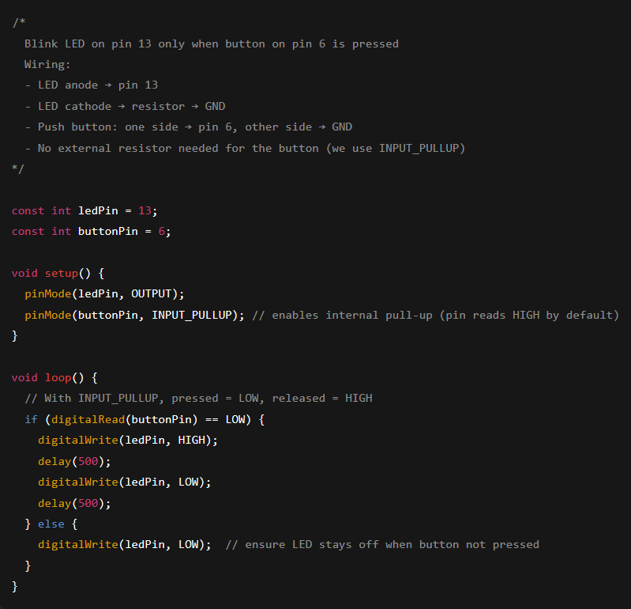
Code: Task 2
What the code does (quick tour)
const int ledPin = 13; const int buttonPin = 6;: names your pins for readability.
pinMode(buttonPin, INPUT_PULLUP): turns on the internal pull-up resistor.
That means pin 6 sits at HIGH by default.
Pressing the button connects pin 6 to GND → it reads LOW.
digitalRead(buttonPin): checks the button state each loop.
If pressed (LOW), we blink the LED with two delay(500) calls (0.5s on/off).
If not pressed, we force the LED LOW so it’s off.

Slide 10
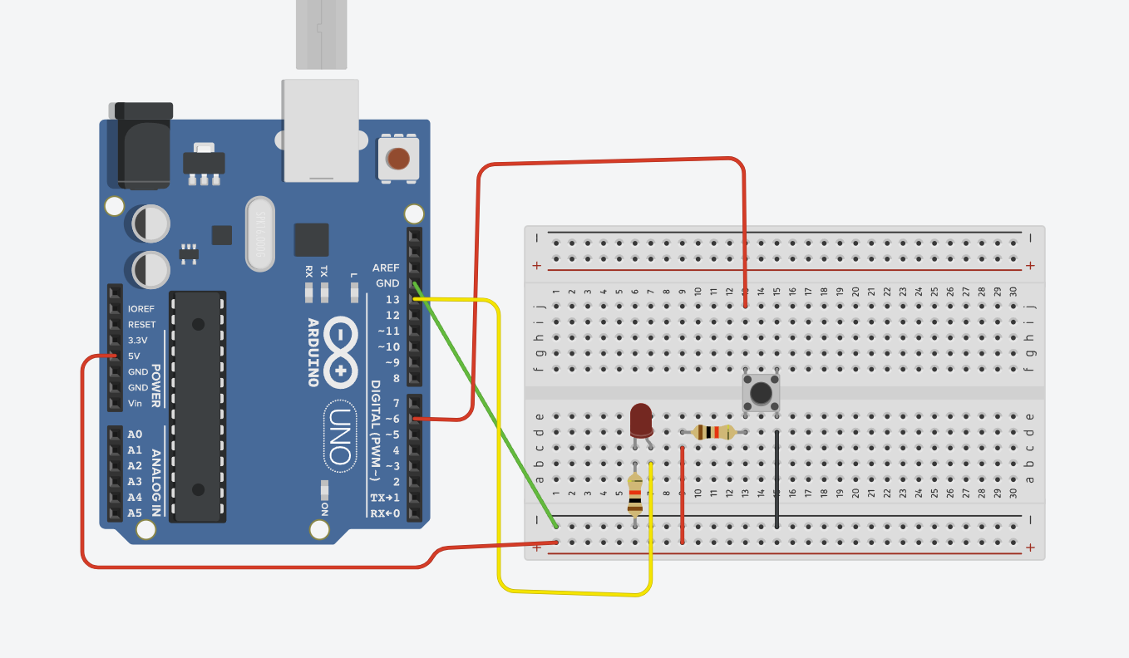

Slide 11
Learning Outcomes
Understand basic Arduino wiring and components.
"Learn digital output (LED) and input (button).
Practice coding with pinMode, digitalWrite, digitalRead, and delay.
Build foundation for more advanced interactive projects.

Slide 12
Homework: LED Traffic Signal with Two Buttons
Create a small “traffic light” on your Arduino UNO that:
Uses three LEDs (red, yellow, green).
Has two push buttons\:
Button A starts the automatic traffic light sequence\.
Button B immediately stops the sequence and turns all lights off\.\
Цель работы: Собрать макет светофора на Arduino UNO, который:
Управляет тремя светодиодами (красный, жёлтый, зелёный). Использует две кнопки:
Кнопка A запускает автоматический цикл работы светофора.
Кнопка B немедленно останавливает цикл и выключает все лампы.
DUE: 25/09/2025

